Slide 1
Container Security with Falco
Sam Gabrail, Senior Sales Engineer at Sysdig

Slide 2
Agenda
What is Falco?
Falco Architecture and Design
Falco in Action !

Slide 3
What is Falco?

Slide 4

Falco
Open Source Runtime Behavioral Activity Monitor Container Native Infrastructure
CNCF Sandbox Project
Docker and Kubernetes aware
and other…

Slide 5
What does Falco actually do?

Slide 6
Form Factor
falco.org/docs/installation
Linux Program $ apt-get install -y falco
Linux Container $ docker run falcosecurity/falco

Slide 7
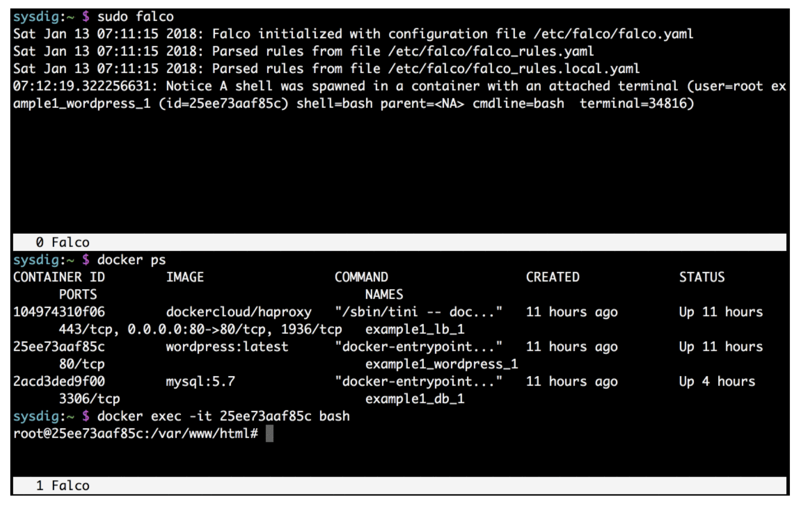

In a nutshell…
2)
1)

Slide 8
How does Falco do it?

Slide 9
It all started with Sysdig…

Slide 10
Single host
Bare-metal or Virtual Machine
cassandra
nginx
(container)
mongo
(container)
Java Virtual Machine
Userspace
POSIX interface
Kernel

Slide 11
Kernel Instrumentation
Programs and Containers System Calls
Falco
Rule engine
cassandra
nginx
(container)
myapp
(container)
Falco Ruleset
Filtering
System
call
Collector
…
…
JVM
Userspace
Kernel
tracepoint
eBPF or Kernel Module
system call
Host

Slide 12
User Space Filtering
Complex filtering engine
Sysdig
cassandra
nginx
(container)
myapp
(container)
Filtering
System
call
Collector
…
…
JVM
Userspace
Kernel
tracepoint
Linux Kernel Module
system call
Host

Slide 13
Support for eBPF
Sysdig
cassandra
nginx
(container)
myapp
(container)
Filtering
System
call
Collector
…
…
JVM
Userspace
Kernel
tracepoint
eBPF
system call
Host
February 27, 2019 - sysdig.com/blog/sysdig-and-falco-now-powered-by-ebpf

Slide 14
Beyond System Call

Slide 15
Instrumentation
Statsd metrics
Sysdig
cassandra
nginx
(container)
myapp
(container)
Filtering
statsd
System
call
Collector
Statsd
metric
Collector
…
JVM
eBPF
Host

Slide 16
Instrumentation
JMX metrics
Sysdig
cassandra
nginx
(container)
myapp
(container)
Filtering
System
call
Collector
…
JMX
metric
Collector
JVM
JMX
eBPF
Host

Slide 17
Back to Falco

Slide 18
Detection workflow
A shell was used as the entrypoint/exec point into a container with an attached terminal.
ALERT
!
Falco
condition: >
spawned_process and container
and shell_procs and proc.tty != 0
and container_entrypoint
Rule engine
cassandra
nginx
(container)
myapp
(container)
Falco Ruleset
Filtering
System
call
Collector
…
…
JVM
clone + exec shell
interface
eBPF or Kernel Module
Host

Slide 19
Falco Rules
- rule: Terminal shell in container
desc: A shell was used as the entrypoint/exec point into a container with an attached terminal.
condition: >
spawned_process and container
and shell_procs and proc.tty != 0
and container_entrypoint
output: >
A shell was spawned in a container with an attached terminal (user=%user.name %container.info shell=%proc.name parent=%proc.pname
cmdline=%proc.cmdline terminal=%proc.tty)
priority: NOTICE
tags: [container, shell]
falco.org/docs/rules/default-custom/

Slide 20
Falco and Kubernetes

Slide 21
Kubernetes
Host
Host
Host
SVC (1)
SVC (2)
SVC (3)

Slide 22
Falco Daemonset
Falco
Falco
Falco
Host
Host
Host
Falco
SVC (1)
Daemonset
SVC (2)
SVC (3)
github.com/falcosecurity/falco/tree/dev/integrations/k8s-using-daemonset

Slide 23
Orchestrator Metadata
Orchestrator
metadata
ClusterName: demo-kubeaws KubernetesNodeName: ip-10-1.ec2.internal Deployment: example-demo-app
Kubernetes
API Server
Falco
dev
prod
Rule engine
nginx
(container)
myapp
(container)
Falco Ruleset
Filtering
System
call
Collector
…
…
ebpf

Slide 24
Kubernetes Audit Events
ALERT
!
Delete Pod myapp
Kubernetes
API Server
Falco
Rule engine
nginx
(container)
myapp
(container)
Falco Ruleset
Filtering
System
call
Collector
Webhook
k8s audit
…
Kubernetes Audit Events (json stream)
ebpf
November 12, 2018 - sysdig.com/blog/falco-0-13-released-kubernetes-audit-support/

Slide 25
Falco Rules
Container Metadata and Kubernetes Audit Events
# Detect any new pod created in the kube-system namespace
- rule: Pod Created in Kube Namespace
desc: Detect any attempt to create a pod in the kube-system or kube-public namespaces
condition: kevt and pod and kcreate and ka.target.namespace in (kube-system, kube-public)
output: Pod created in kube namespace (user=%ka.user.name pod=%ka.resp.name ns=%ka.target.namespace image=%ka.req.container.image)
priority: WARNING
source: k8s_audit
tags: [k8s]

Slide 26
Falco as a building block

Slide 27
Elasticsearch, Fluentd and Kibana
Kibana
ElasticSearch
Fluentd
Stdout
Syslog
File
Shell
Falco
Alerting
Rule engine
Filtering
System
call
Collector
…
…
sysdig.com/blog/kubernetes-security-logging-fluentd-falco

Slide 28
EFK Falco
sysdig.com/blog/kubernetes-security-logging-fluentd-falco

Slide 29

Join the community.
Website
https://falco.org
Public Slack
http://slack.sysdig.com/
https://sysdig.slack.com/messages/falco
Blog
https://sysdig.com/blog/tag/falco/
Github
https://github.com/falcosecurity/falco
Documentation
https://github.com/falcosecurity/falco/wiki
Docker Hub
https://hub.docker.com/r/falcosecurity/falco/

Slide 30
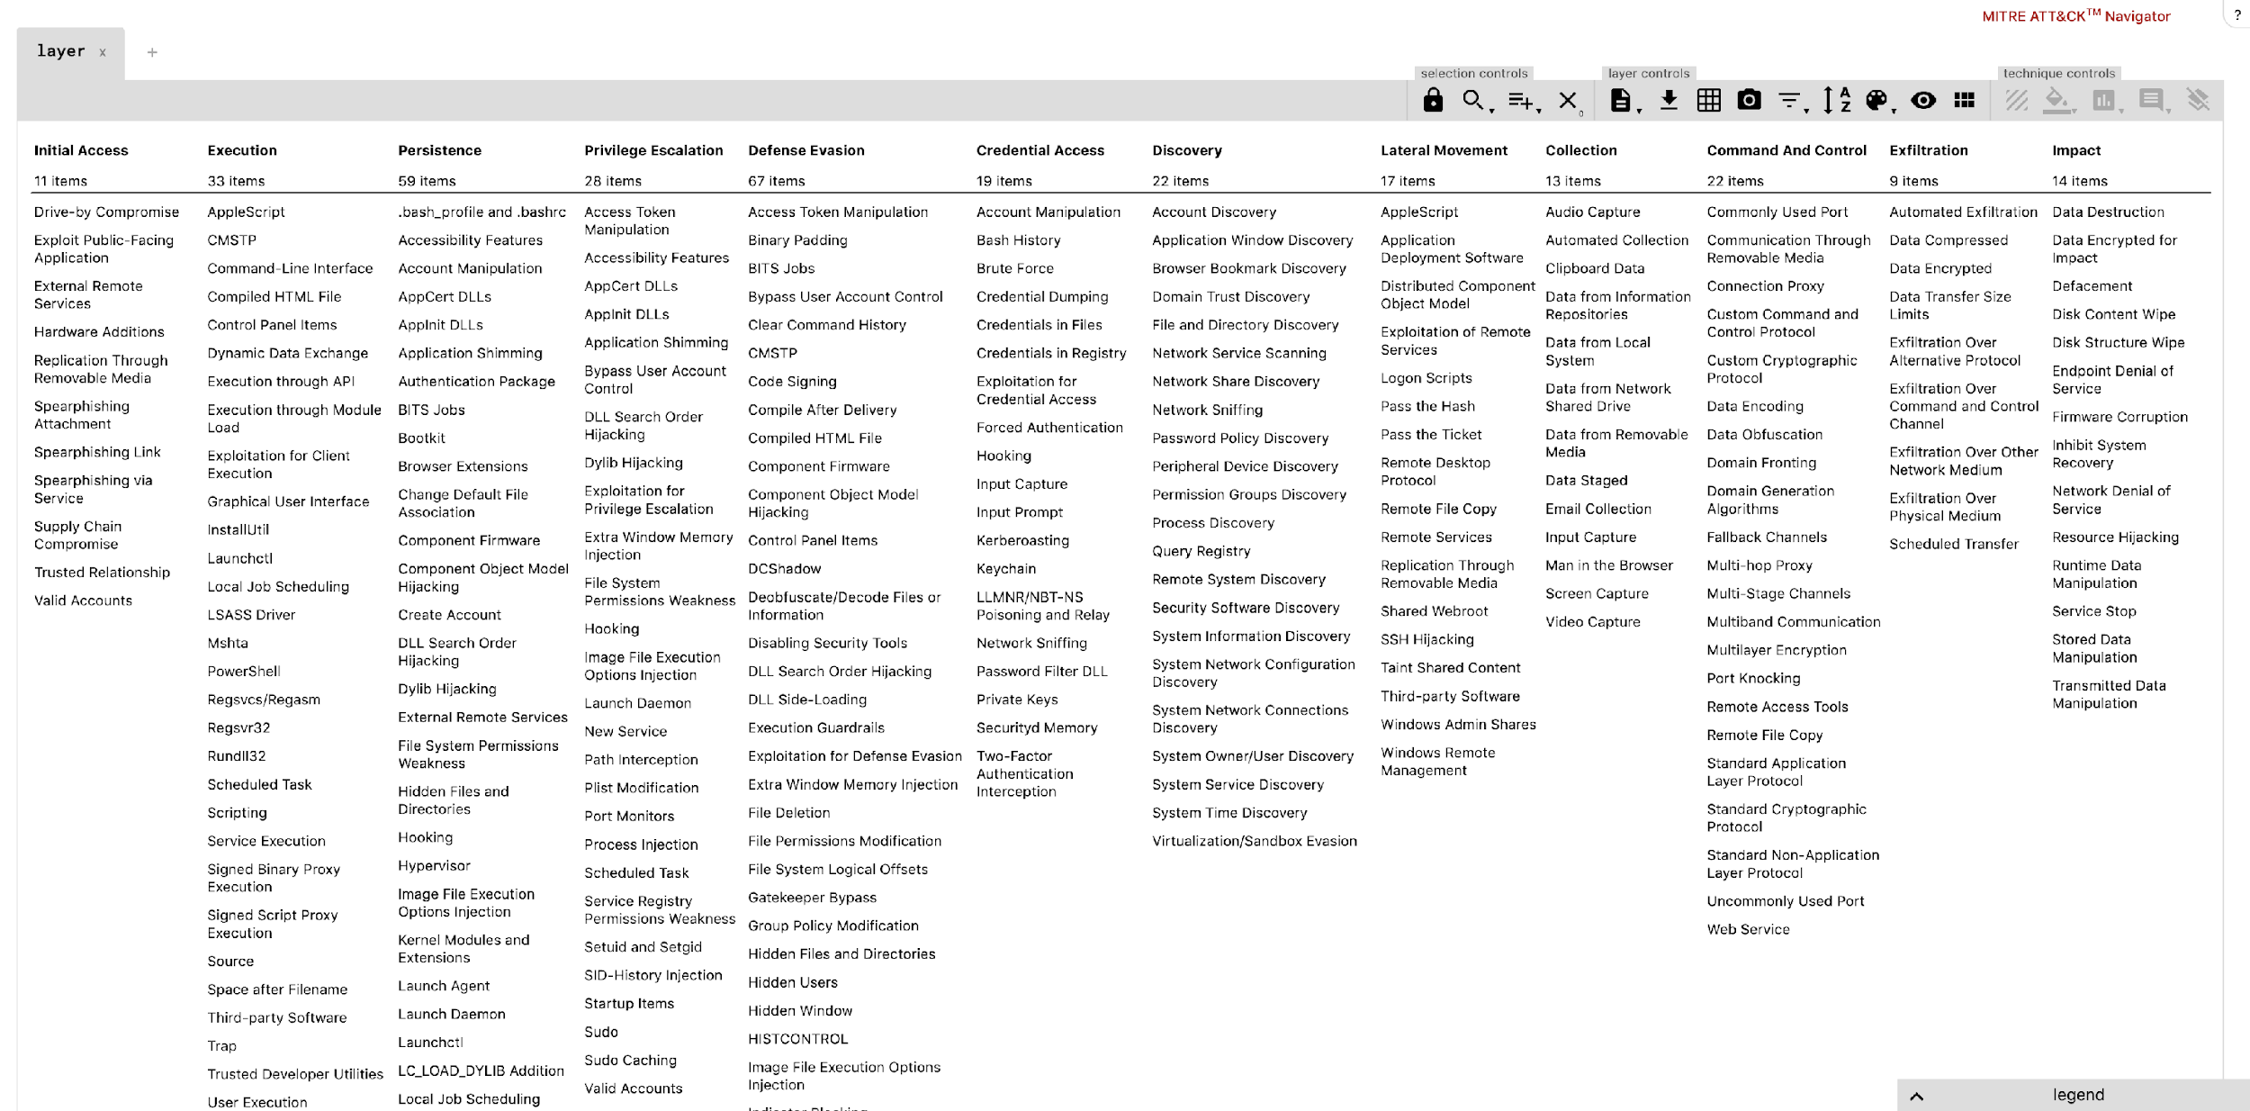
Demo: Runtime Security with Falco
Demos
Privilege Escalation: Launch Privileged Container
Execution: Run a terminal shell in container
Discovery: Launch Suspicious Network Tool in Container
Credential Access: Search Private Keys or Passwords
Defense Evasion: Delete Bash History
Links:
MITRE ATT&CK Matrix
MITRE ATT&CK framework for container runtime security with Falco

